Slide 1
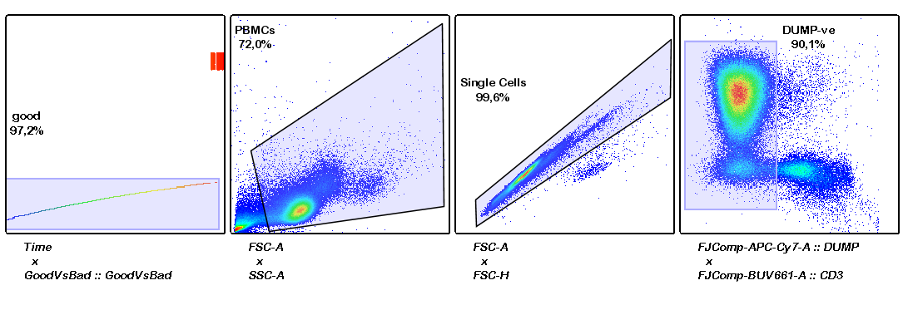
cell-subset selection for hypothesis-agnostic investigation PBMCs on cytotoxic panel

Slide 2
Dimensionality reduction visualization of 50 meta-clusters:

Slide 3
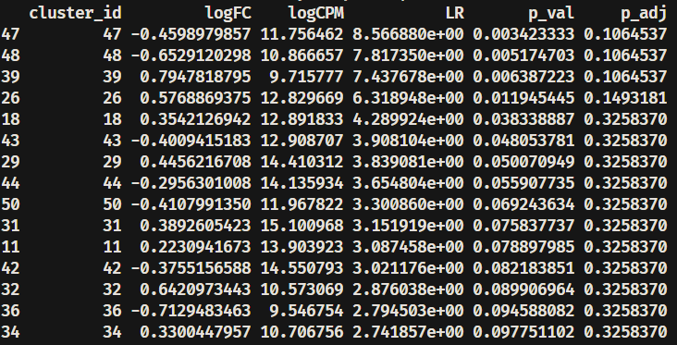
Preliminary results (DA):

Slide 4
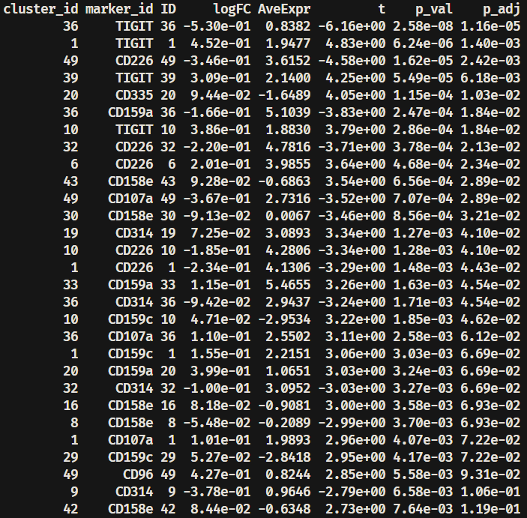
Preliminary results (DS):

Slide 5
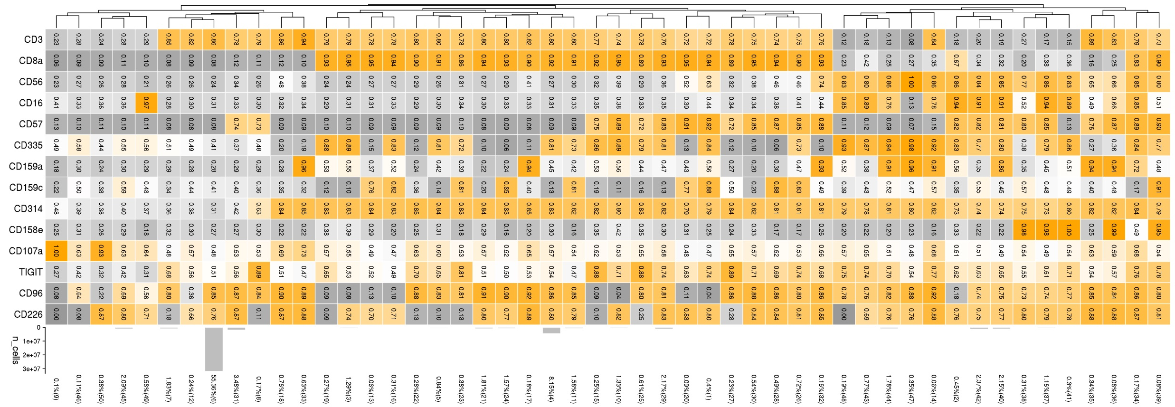
Heatmap of 50 meta-clusters:
Prop% (cluster ID)

Slide 6
Centered log-ratio (CLR):

Slide 7
Pseudobulk-level MDS plot(pbMDS):

Slide 8
Expression pattern of markers:

Slide 9
alive CD14- CD19- PBMCs
CD3-
CD3+
CD56+++
CD56+
CD56-
CD57-
CD57+
CD16+++
CD16-
CD8a+
CD8a-
CD56+
CD56-
CD56+
CD56-
meta-cluster merging strategy:
final clusters
undefined clusters
PMID: 32271902
PMID: 11454057
47
PMID: 20829113
1,10,15,20,25,
26,27,28,29,30,
32,34,39
8,14,31,35,36
41,43, 44, 48
49
2,37,38,40,42
9,45,46,50
3,4,5,11,13,16,17,
19,21,22,23,24
6,7,12,18,33

Slide 10
alive CD14- CD19- PBMCs
CD3-
CD3+
CD56+++
CD56+
CD56-
CD57-
CD57+
CD16+++
CD16-
CD8a+
CD8a-
CD56+
CD56-
CD56+
CD56-
meta-cluster merging strategy:
NK clusters
T lymphocytes
undefined clusters

Slide 14
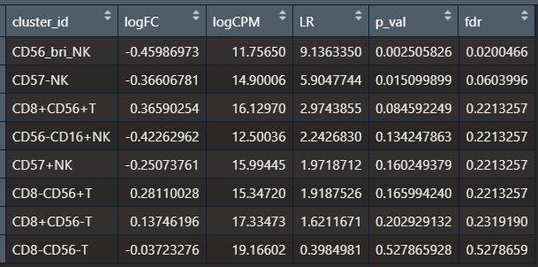
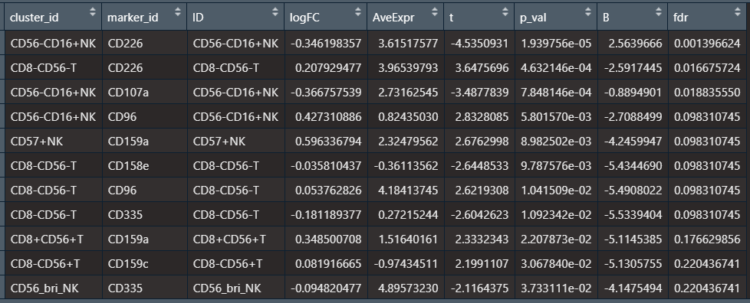
Final results:

Slide 15
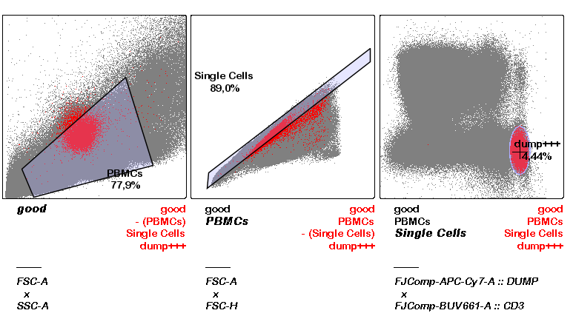
Expression pattern of “type” markers:

